Slide 1
Secure data hiding in images using steganography
CAPSTONE PROJECT
Presented By:
Student Name : Annyasha Mondal
College Name & Department : Ms Ramaiah University Of Applied Sciences , School Of Social Sciences, BSc(Hons) Data Science And Analytics

Slide 2
OUTLINE
Problem Statement
Technology used
Wow factor
End users
Result
Conclusion
Git-hub Link
Future scope

Slide 3
Problem Statement
Traditional encryption methods attract attention, making data vulnerable to attacks. Steganography conceals sensitive information within images, ensuring secure and undetectable communication. However, existing methods face challenges like low embedding capacity and susceptibility to detection. This project aims to develop an efficient and robust image steganography technique to enhance security, imperceptibility, and resistance to attacks.

Slide 4
Technology used
Python – The primary programming language for implementing steganography.
OpenCV (cv2) – Used for image processing and manipulation.
File Handling (os module) – Opens and saves the encrypted image.
String Encoding (ASCII Mapping) – Maps characters to pixel values for embedding and extraction

Slide 5
Wow factors
Password-Protected Decryption – Ensures only authorized users can retrieve hidden data.
Minimal Image Distortion – Embeds data without significantly altering image quality.
Custom ASCII Mapping – Uses unique character-to-pixel value encoding for security.
Lightweight & Fast – Uses OpenCV for efficient image processing.
Cross-Platform Compatibility – Works on multiple operating systems with minor modifications

Slide 6
End users
Government & Intelligence Agencies – Secure communication without attracting attention.
Corporate Organizations – Protect sensitive business data from cyber threats.
Journalists & Whistleblowers – Share confidential information securely.
Cybersecurity Professionals – Enhance data protection techniques.
General Users – Securely store and transmit personal or confidential data

Slide 7
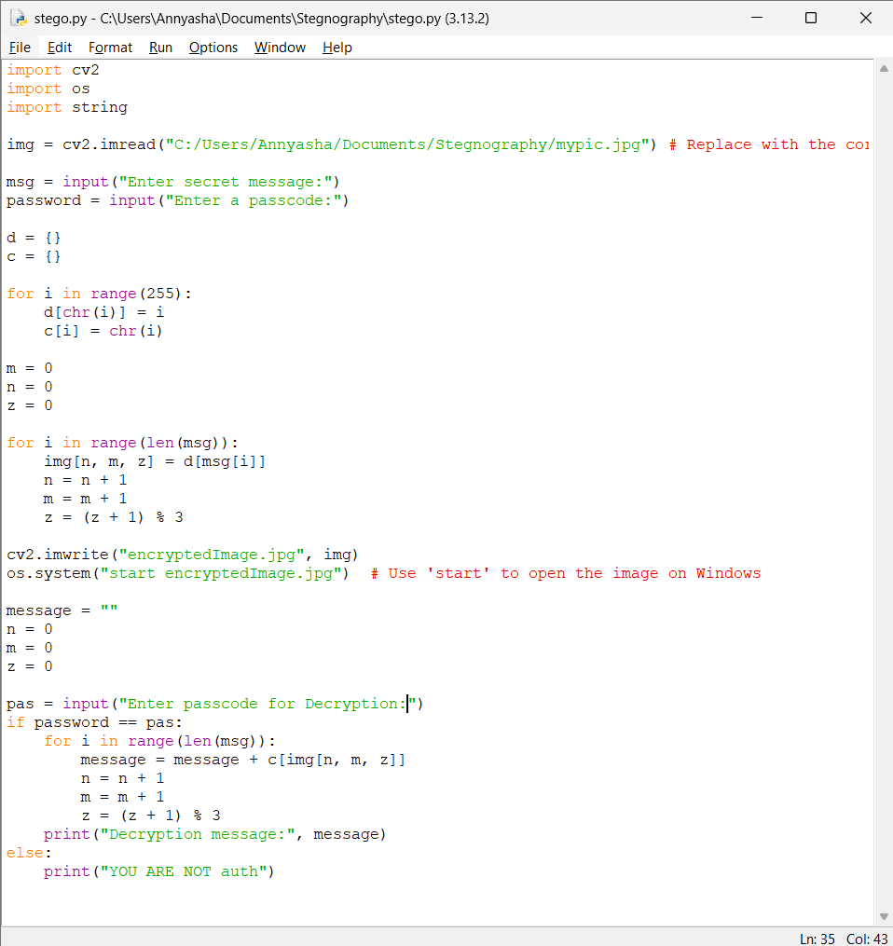
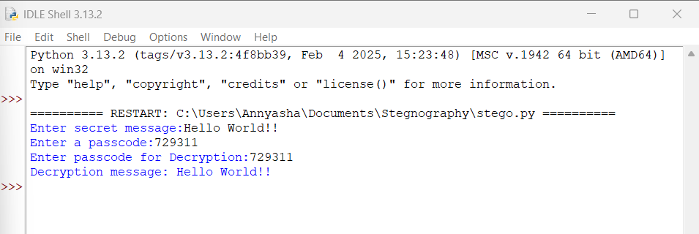
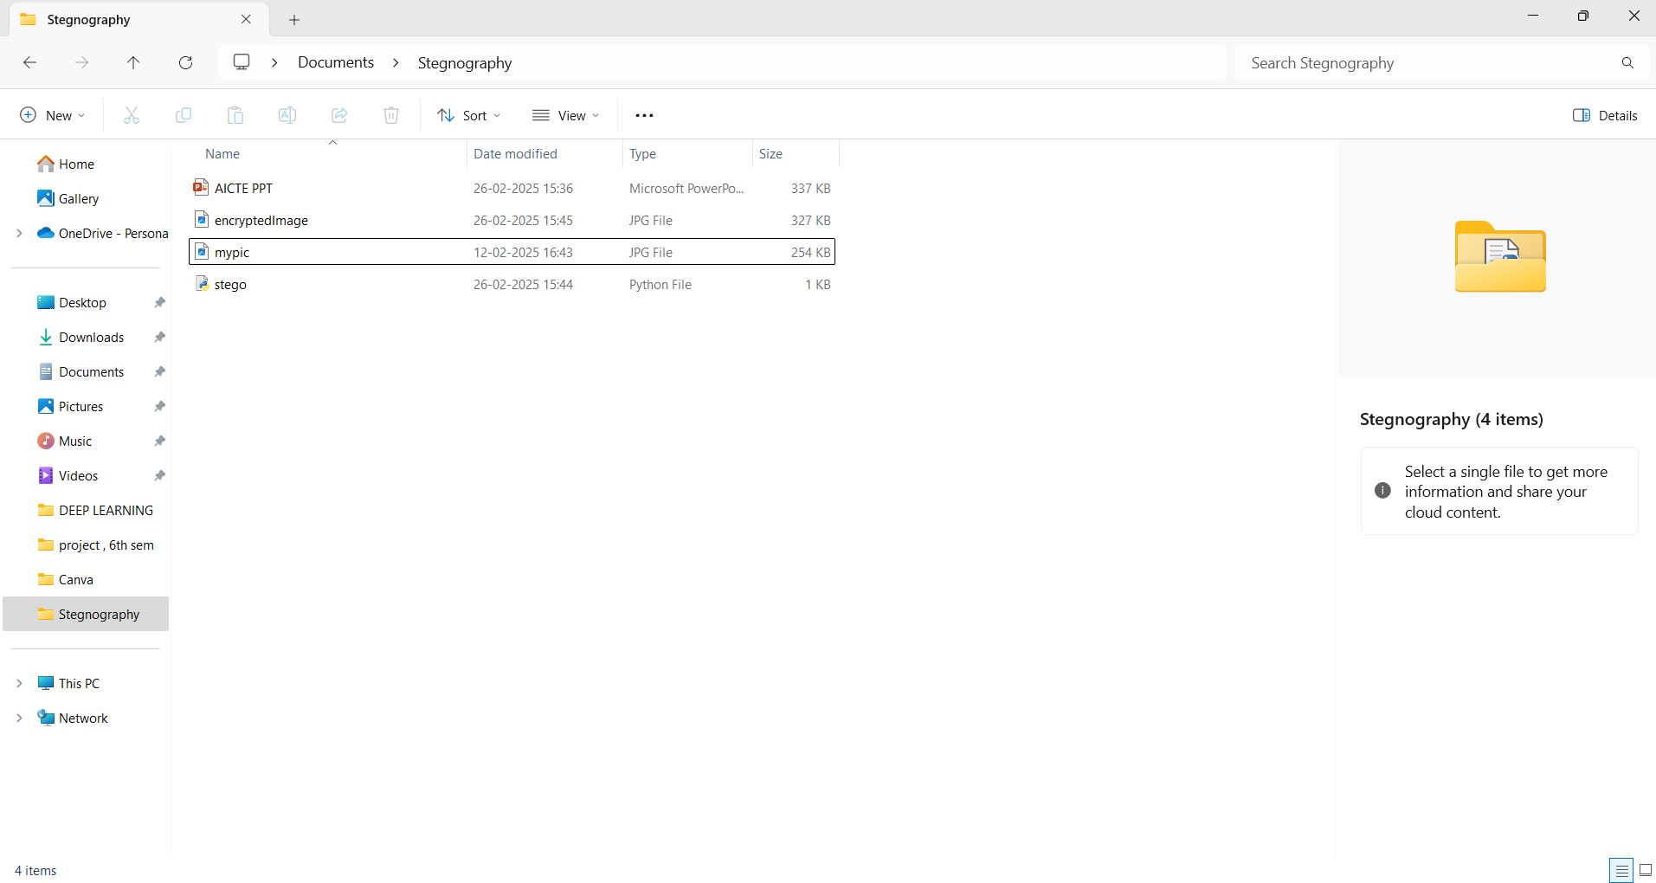
Results

Slide 8
Conclusion
This project successfully implements a secure data-hiding technique using steganography, addressing the challenges of traditional encryption methods. By embedding confidential information within images, it ensures secure and undetectable communication. The use of password-protected decryption enhances security, making the system robust against unauthorized access. This approach provides an efficient and lightweight solution for protecting sensitive data while maintaining image quality and usability.

Slide 9
GitHub Link
Github Link:- https://github.com/Ananyasha1/Stegnography-Project-IBM.git

Slide 10
Future scope(optional)
Advanced Encryption Techniques – Integrating quantum cryptography and AI-based encryption for enhanced security.
Robust Steganographic Algorithms – Developing new methods to resist steganalysis attacks and improve data embedding efficiency.
Real-time Steganography – Implementing steganography in live video streams for secure communication.
Cloud and IoT Security – Using steganography to protect sensitive IoT data and cloud-based transactions.
Blockchain Integration – Combining steganography with blockchain to ensure data integrity and authenticity.
AI-Powered Detection Prevention – Enhancing steganographic techniques to evade AI-based detection methods

Slide 11
THANK YOU

